Slide 1
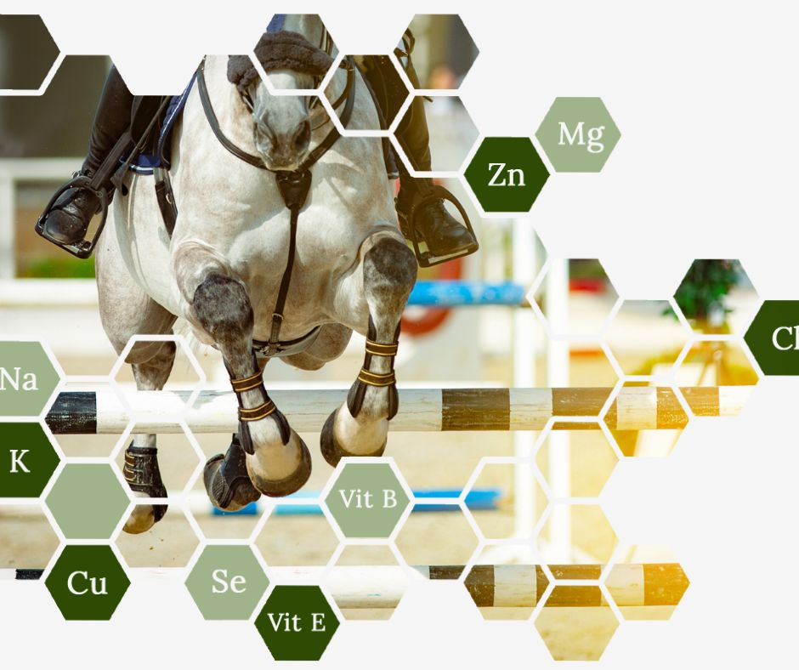
Equine Nutrition
and
Basic Supplementation
Dr Danica Olenick
DVM, BSc(Ag) Animal Nutrition

Slide 2
Topics
Equine Physiology - Hay Analysis
Nutritional Requirements - Supplementation
Equine Nutrition and Basic Supplementation

Slide 3
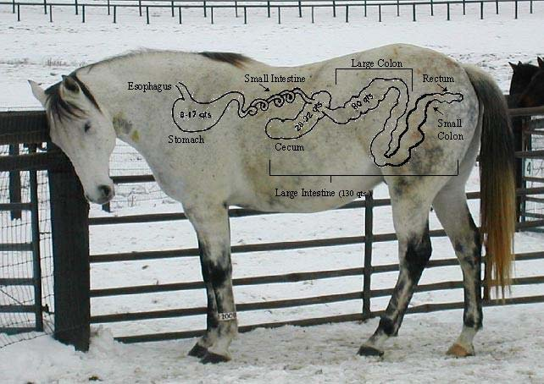
Equine Physiology
Physiology
Nutritional Reqs
Hay
Supplements

Slide 4
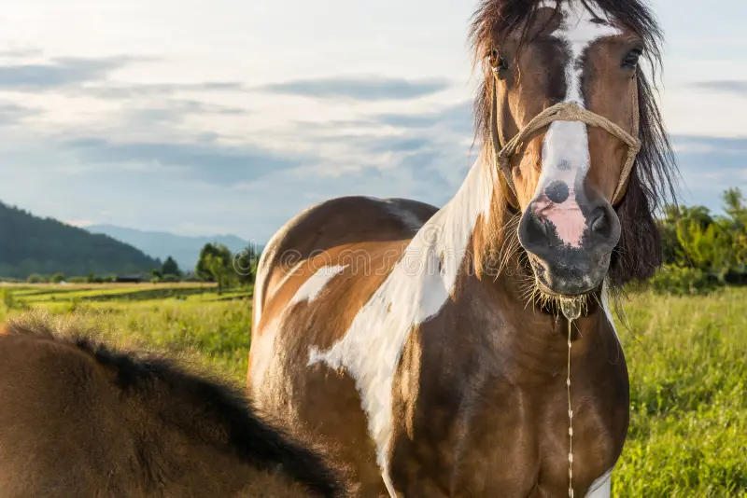
The Foregut:
Mouth, Stomach & Small Intestine
Equine Nutrition and Basic Supplementation
The Mouth
Teeth grind and break up feed into boluses
Dentition major role
Salivary glands produce 35-40L saliva daily
Higher with grass and hay
Lower with grains and pellets
Saliva functions:
Acid Buffer
Lubrication
Electrolytes
No Enzymes

Slide 5
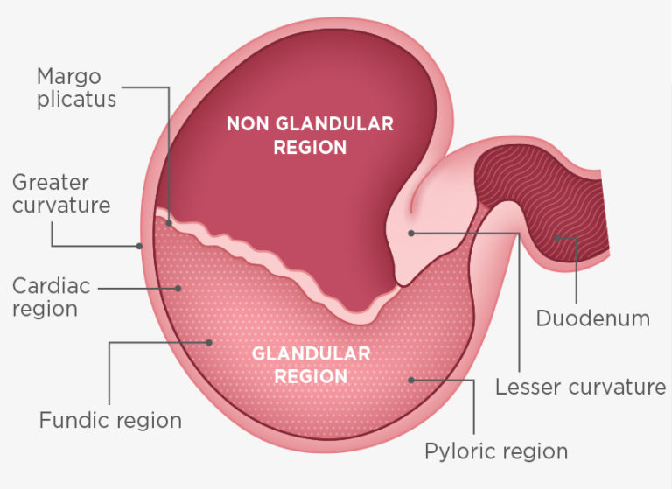
The Foregut:
Mouth, Stomach & Small Intestine
Equine Nutrition and Basic Supplementation
The Stomach
8-15L Capacity
Mucous and Acid Production
Liquifies Feed
Partial Breakdown of Proteins
No Digestion or Absorption of Nutrients

Slide 6
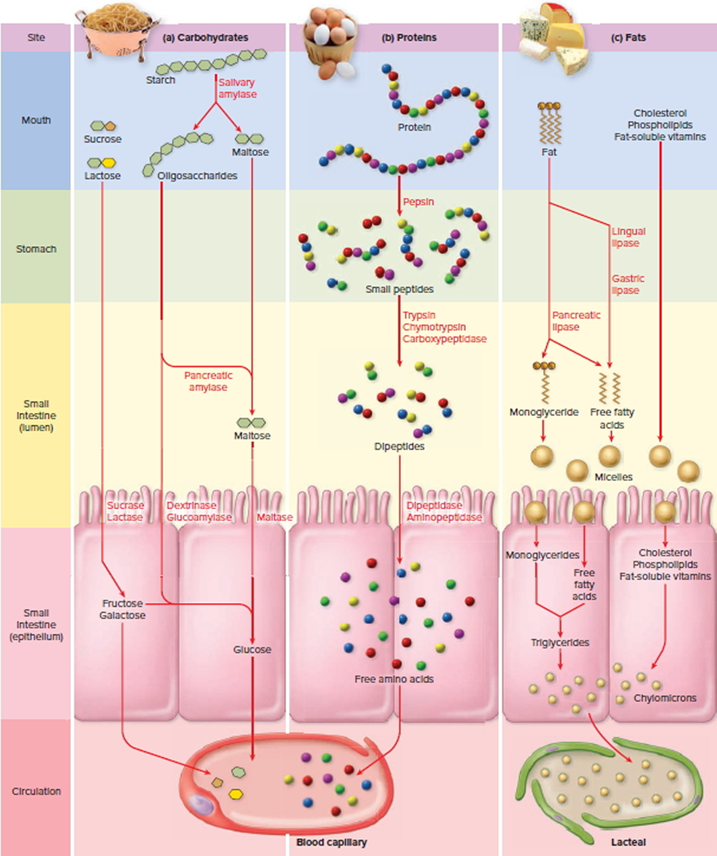
The Foregut:
Mouth, Stomach & Small Intestine
Equine Nutrition and Basic Supplementation
Small Intestines
20m long, 60L capacity
Rate of passage 45-120 min
Neutralizes acid from stomach
Enzymatic digestion of protein, starch, sugar, fat
Absorption of amino acids, fats, simple sugars, vitamins, minerals

Slide 7
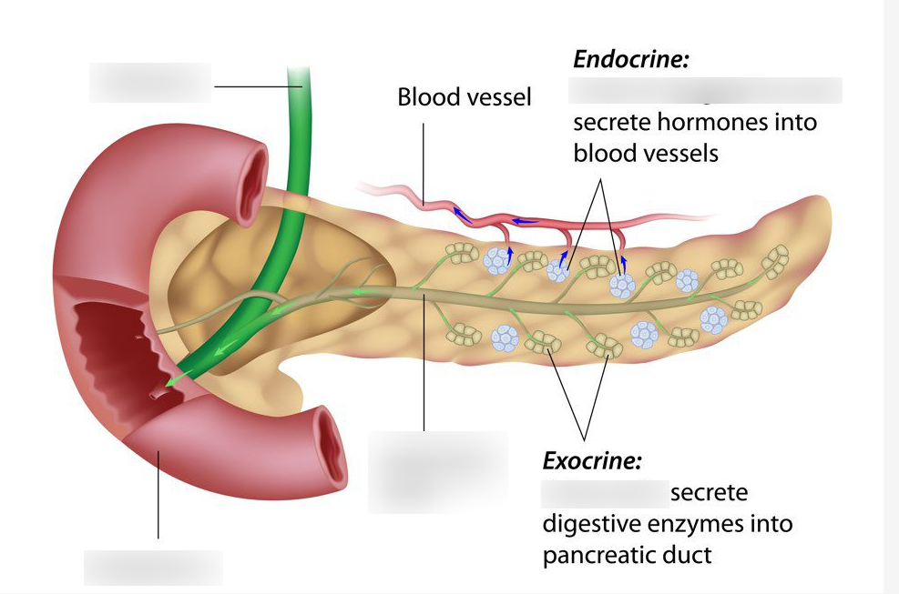
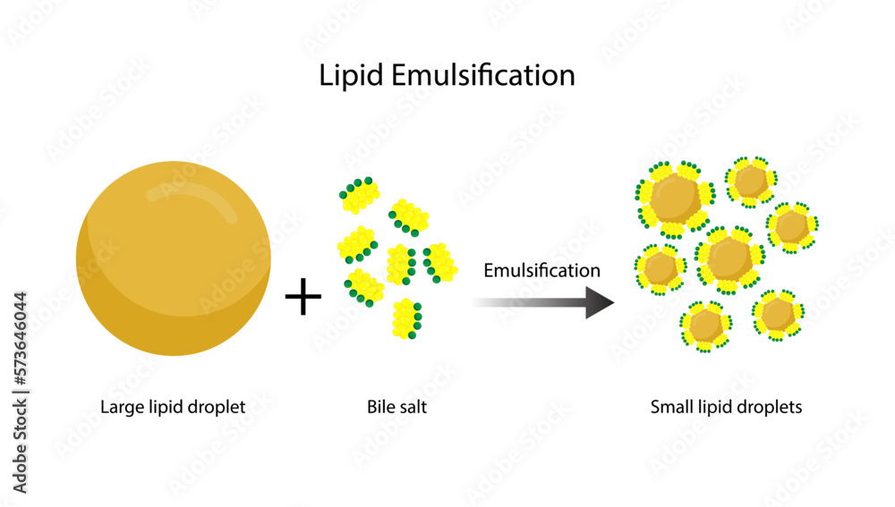
The Foregut:
Mouth, Stomach & Small Intestine
Equine Nutrition and Basic Supplementation
Accessory Organs
Pancreas
Produces Acid Buffer, Releases into SI
Produces Digestive Enzymes, Releases into SI
Produces Insulin, Releases into Bloodstream
Liver
Produces Bile Salts for Fat Emulsification
Glucose and VFA Processing
Fat and Protein Processing
Some Vitamin synthesis

Slide 8
The Hindgut:
Fermentation Organs
Equine Nutrition and Basic Supplementation
Site of Microbial Digestion thru Fermentation
Incl Cecum, Large and Small Colon
7m long, 125L Capacity
Rate of passage 24-48hr
Relatively Neutral pH (6-7)
Fiber Fermentation, not Digestion
End products:
Volatile Fatty Acids (VFAs)
Vitamins B and K
Gas

Slide 9
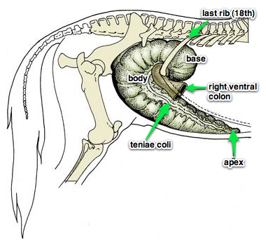
The Hindgut:
Fermentation Organs
Equine Nutrition and Basic Supplementation
Caecum
1.2m long, 30L capacity
Fermentation of Fiber: Structural CHO
Fermentation of excess Non-Structural CHO
VFA Production and Absorption
All B Vitamin and Vitamin K Synthesis

Slide 10
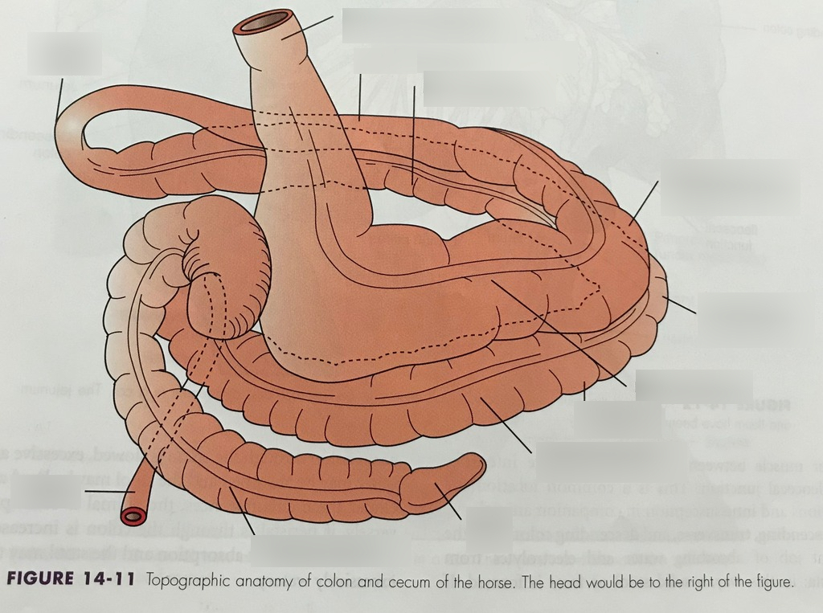
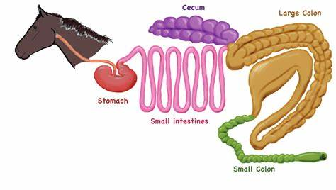
The Hindgut:
Fermentation Organs
Equine Nutrition and Basic Supplementation
Large Colon
3-3.5m long, 75L capacity
Same functions as Caecum
Water Absorption
Small Colon
3-3.5m long, 20L capacity
Water Absorption
Segmentation

Slide 11
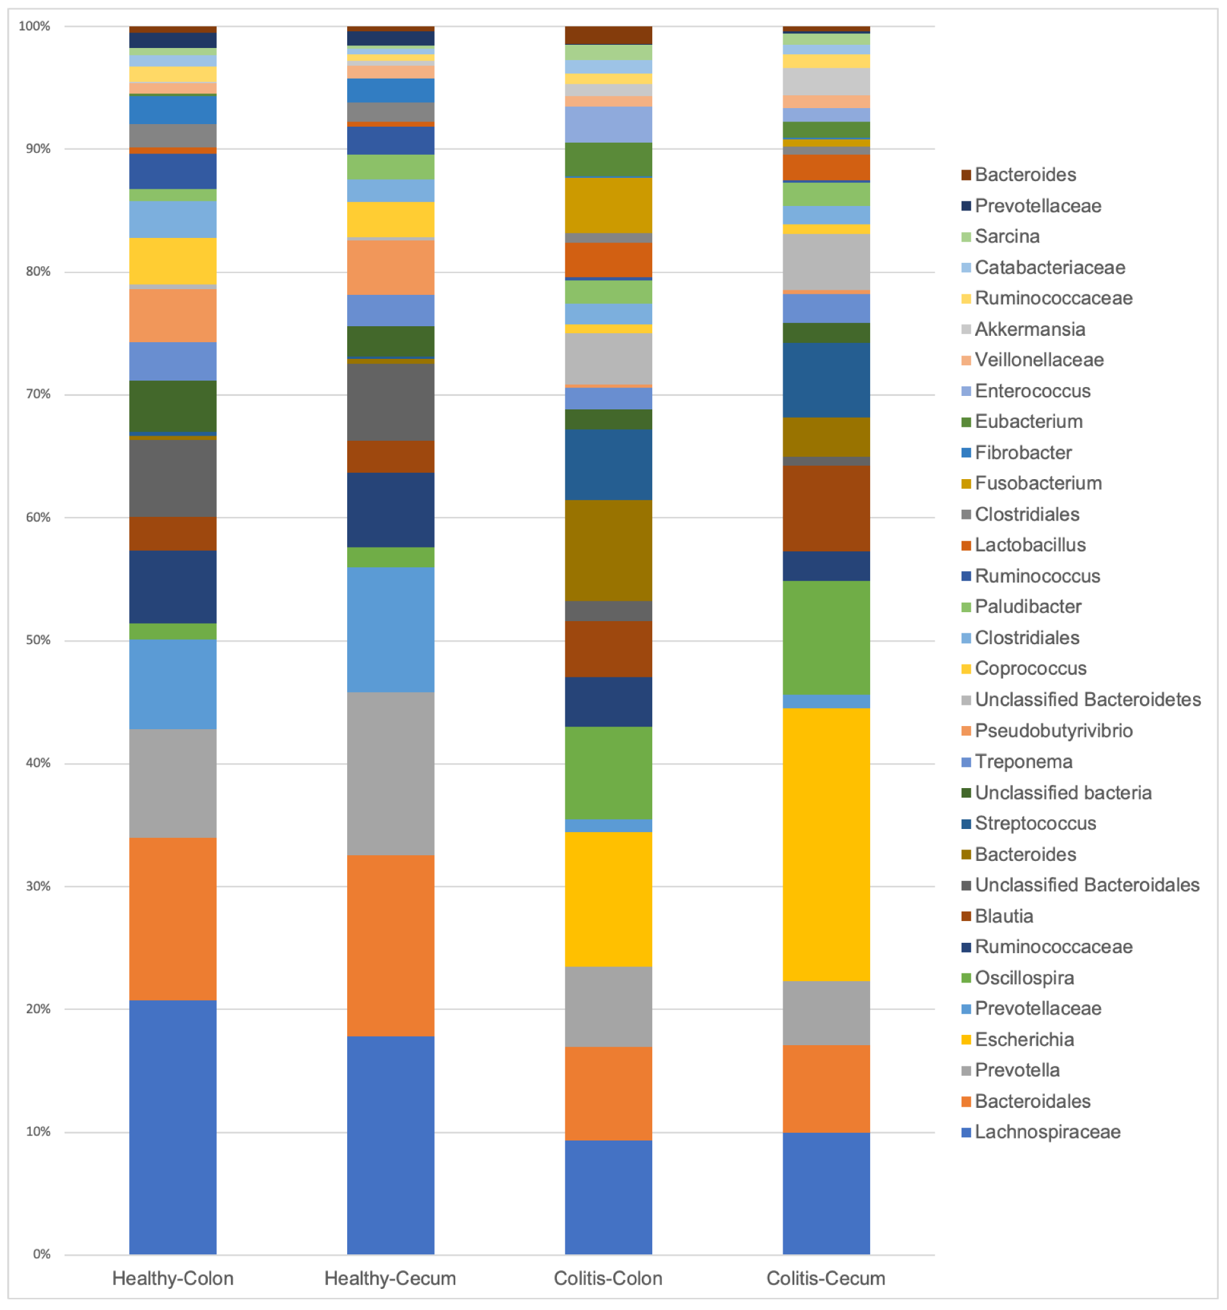
The Hindgut:
Fermentation Organs
Equine Nutrition and Basic Supplementation
Microbiology
Each mL caecal fluid contains
10-50 bil bacteria, 1 mil protozoa, yeast and fungi
~400 species of microbes
Complex interactive web of organisms
Changes to populations, affect other populations
Waste products of some are food for others

Slide 12
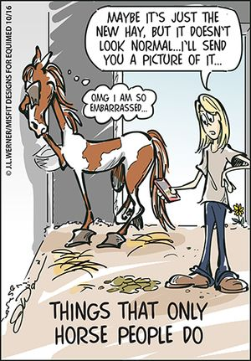

Slide 13
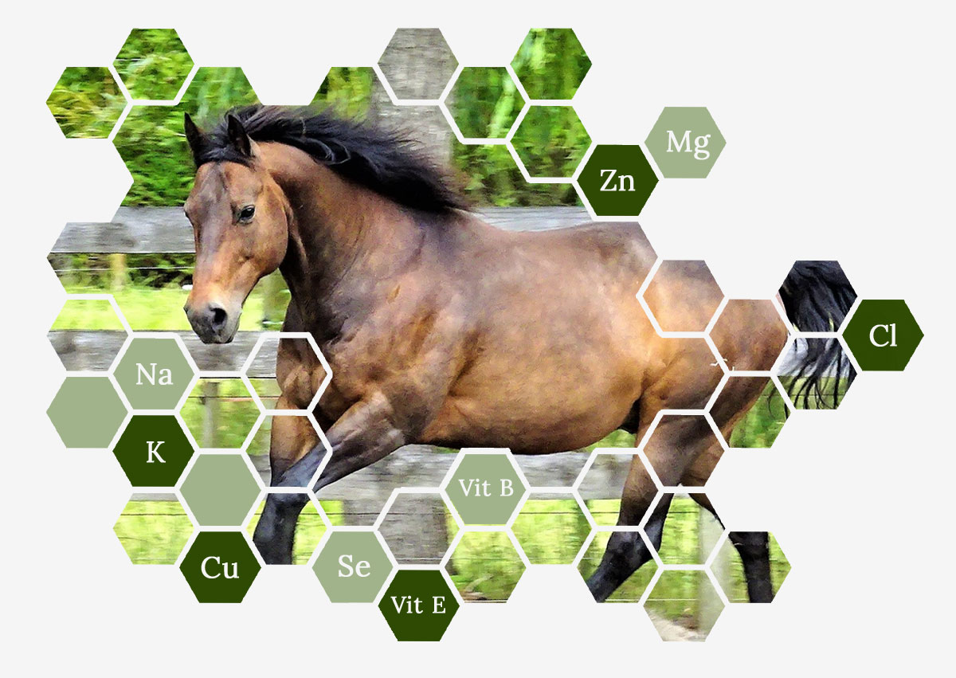
Nutritional Requirements
Physiology
Nutritional Reqs
Hay
Supplements

Slide 14
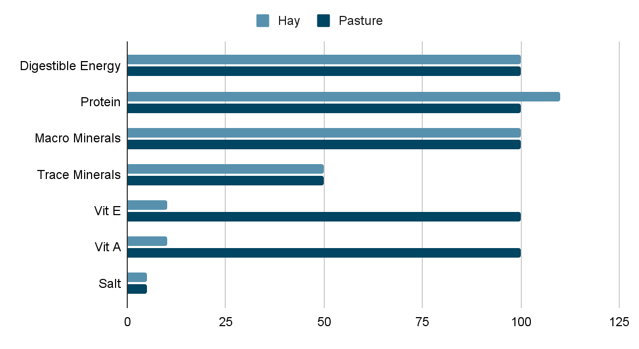
Daily Nutrient Requirements met by Hay vs Pasture
Notes:
Why is more protein met in hay vs pasture?
Basic necessities are good quality hay (high enough in DE and protein), some trace minerals, Vit E, Vit A and salt

Slide 15
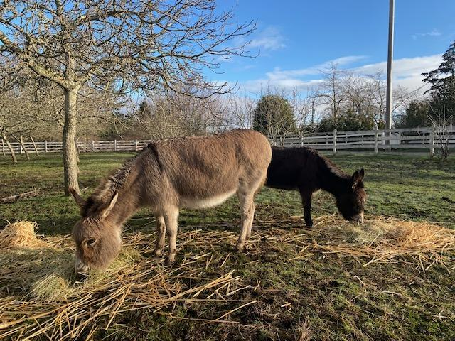
Digestible Energy DE
Components of DE
Simple sugars
Non Structural CHO
Structural CHO (Fiber)
VFAs by-products
Crude Protein
Fats
The amount of energy in the diet that is absorbed by the horse.
DE requirements are calculated based on the horse’s energy required for maintenance + energy expended during exercise.

Slide 16
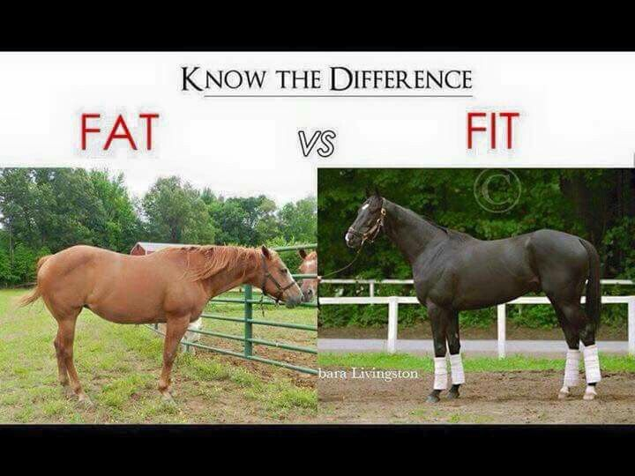
Non-Structural CHO & Simple Sugars
Sources
Digested and absorbed in SI
Glucose end product
Source of quick onset energy
Important for our competitive horses
Triggers Insulin release from pancreas
Excess should be avoided in our EMS horses
Excess is fermented in caecum/colon
Feeding Requirements
<13% Non-EMS & senior horses
<15% Growing and high-performance horses
<11% EMS horses
Hay, pasture
Grains
Pellets and binding agents
Treats, apples, carrots

Slide 17
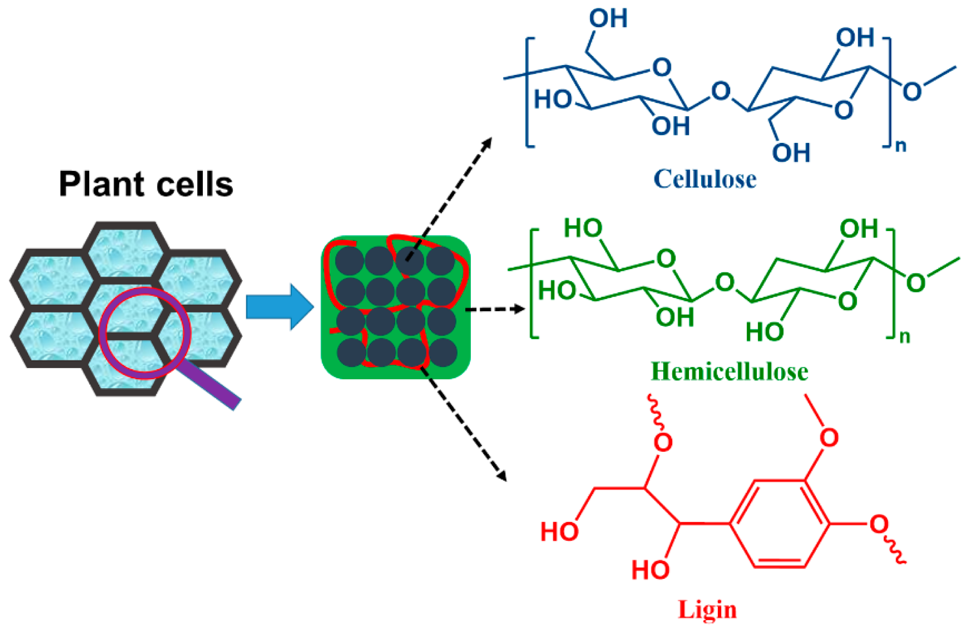
Structural CHO & Fiber
NOT digested or absorbed in SI
Fermented in Caecum/Colon
Rate depends on type of fiber
Starch and fructans rapidly ferment
Hemicellulose and pectins
Cellulose and pectins
Lignins, silica and some cellulose not fermented
VFA end products of fermentation
Ratios vary with plant cell structure
VFA converted to energy or glucose
Source of slow release energy
Sources
Hay, pasture
Grain hulls
Beet pulp
Soy hulls

Slide 18
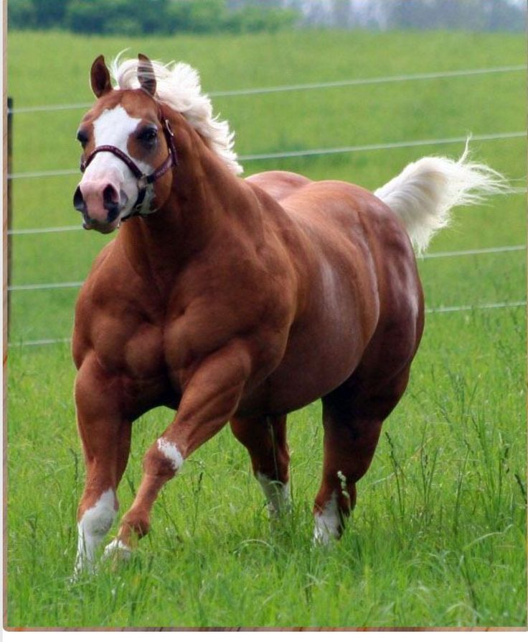
Crude Protein (CP)
COMPANY NAME
Sources
Digested and absorbed in SI only
Excess CP is fermented in Caecum/Colon
Composed of 22 amino acids
Poor quality/imbalanced amino acids are metabolized and excreted thru kidneys
Analysis can be misleading
Feeding excess should be avoided in horses with kidney disease and seniors*
Seniors have increased need for CP but also may have kidney function loss
Hay, pasture
‘Meals’

Slide 19
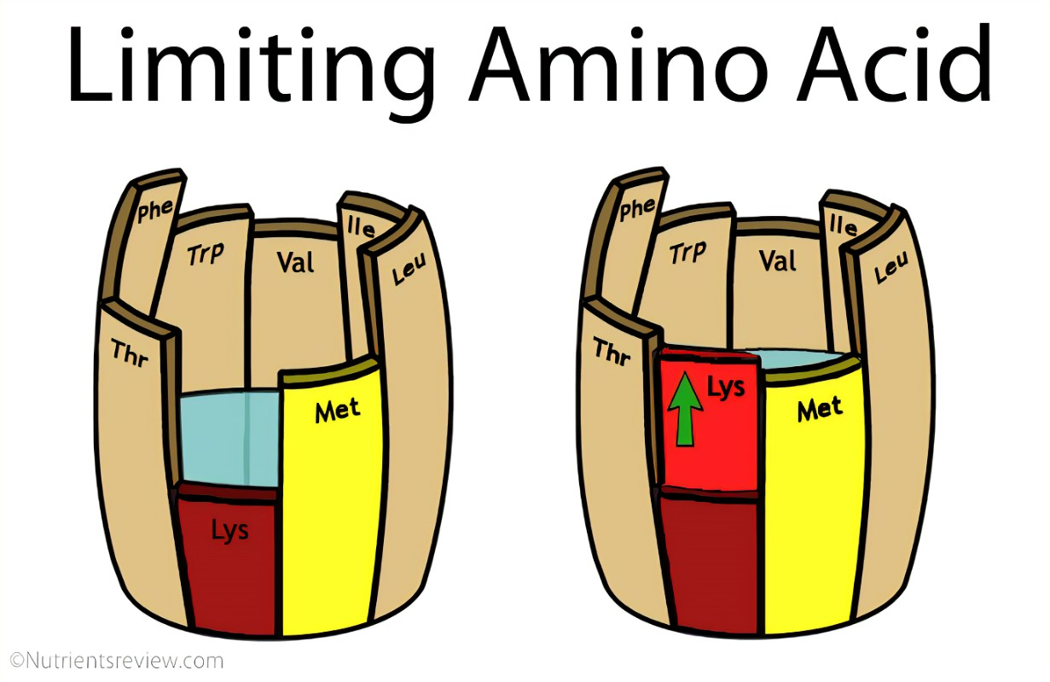
Amino Acids
Non-essential vs Essential Amino Acids
12 of 22 AAs are synthesized by horse (Non EAA)
10 others need to be in feed (EAA)
Essential vs Limiting AAs
Some EAA are bountiful in feed
Most deficient EAA are called ‘Limiting EAAs’
Quality protein source is one that includes limiting EAAs
Lysine
Methionine
Threonine
Quality vs Quantity
Barrel Analogy

Slide 20
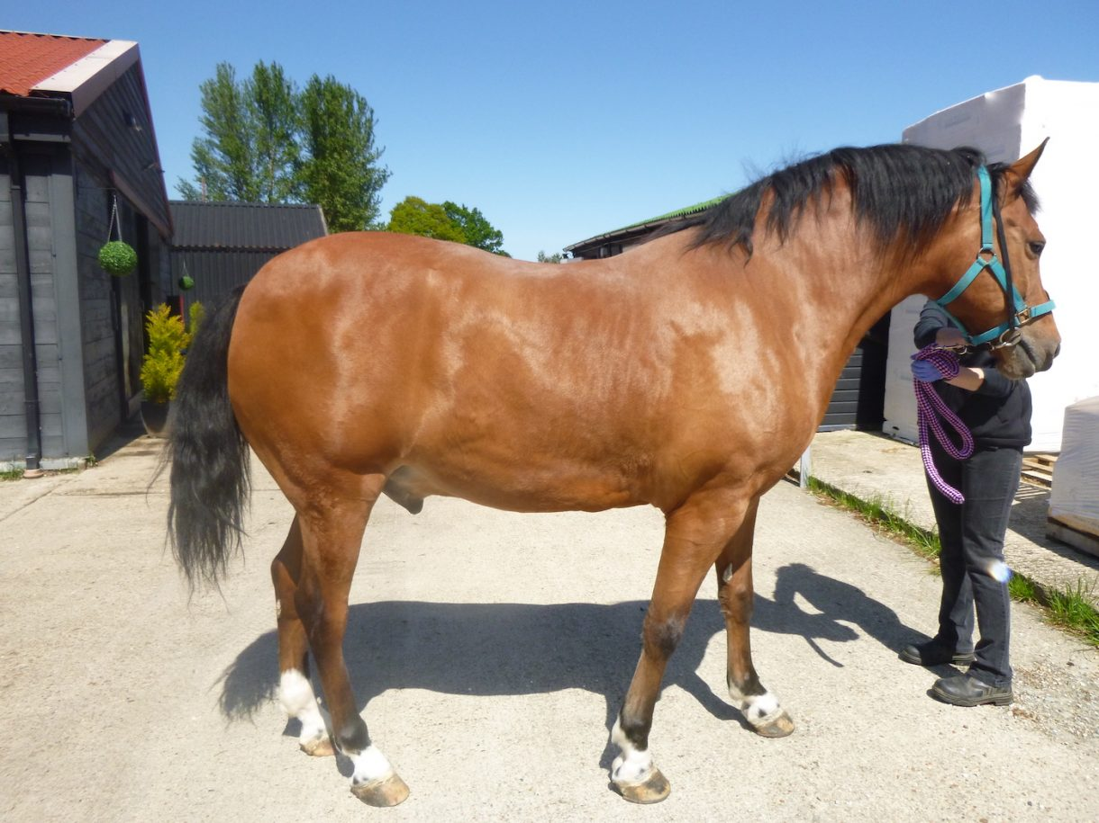
Fats
Sources
No specific requirements for fat in horses
Typical diet of pasture, hay and concentrate is generally low in fat (2-4% of DE)
No bile duct to store bile salts
Horses can tolerate more fat if introduced slowly
Liver needs time to adjust to additional bile salt production
Fats should be avoided in horses with liver disease
Oils
Ground seeds

Slide 21
Macrominerals
Ca & P
Ratio is important : ~1.5-2:1
Important for bone development, muscle function and growth
Increased need in young (2x), late pregnancy (2x) and lactation (3x)
Seniors require more P and less Ca (kidney disease)
Deficiencies can lead to nerve and muscle dysfunction, orthopedic issues, lameness

Slide 22
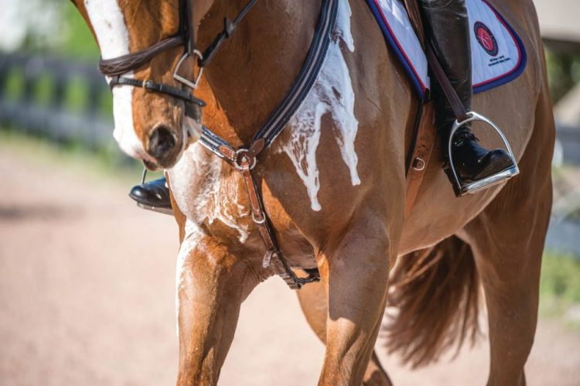
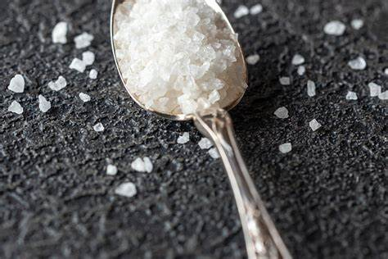
Macrominerals
Na & Cl
Req ~ 50gm per day *varies with work and sweating
Can lose > 30gm (2 Tbsp) salt in 1-2 hrs heavy work
Mod exercise (2x), heavy exercise (4x)
Important electrolytes, maintain fluid balance, acid/base balance, nerve and muscle function, and support digestion
Deficiencies can lead to fatigue, tying up, muscle spasms, anhydrosis

Slide 23
Macrominerals
K
High forage rations do not req supplementation
Exception: acute large losses (endurance)
K greater (1.5-1.8x) to replace loss in milk, sweat and
urine due to kidney failure
Important electrolyte, maintains fluid balance, nerve and muscle function, and cell function
Deficiencies can lead to fatigue, weakness, muscle tremors, anorexia

Slide 24
Macrominerals
Mg
High forage rations usually meet Req
Mg greater for exercising (2x) due to loss in sweat and lactating (3x) due to loss in milk
Important for muscle and nerve function, energy metabolism, insulin sensitivity and bone formation
Deficiencies are rare but low Mg can cause excitation, GI issues
S
Usually adequate if CP Req met
S containing aa (methionine) and vitamins (biotin) essential for hoof growth
Deficiency may contribute to poor hoof quality

Slide 25
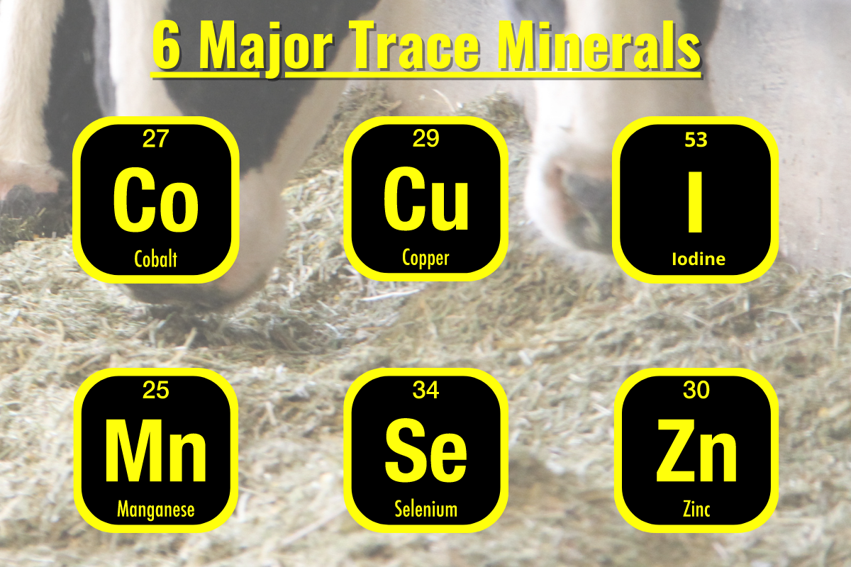
Trace Minerals
Co
Important in B12 synthesis, RBC formation, metabolism
Incorporated into Vit B12 in Caecum/Colon
Cu
Low levels found in our pastures, soils, water
Important antioxidant, hoof and coat quality
Req ~100-200 mg/day, more for performance, pregnancy, lactation
Cu deficiency may cause OCDs in young, aortic rupture in adults, anemia and pigmentation loss
Zn
Low levels found in our pastures, soils, water
Important antioxidant, hoof and coat quality
Req ~400-800 mg/day, more for performance, lactation
Deficiency can cause poor growth rates, hair loss, skin lesions, white line disease, hoof cracks and inappetance

Slide 26
Trace Minerals
I
Iodized salts in feeds and blocks fulfill requirements
Req 35 mg/kg feed or 40 mg/kg pregnant mares
Excess can cause goiter in mares and foals
Fe
High levels found in our pastures, soils, water
Reg 40 mg/kg feed, 50mg/kg for pregnant/lactating mares
Se
Low levels found in our pastures, soils, water
Important antioxidant, muscle function and immune function
Req ~ 1-3 mg/day
Deficiency can cause white muscle dz, tying up, retained placenta, fertility issues, heart failure

Slide 27
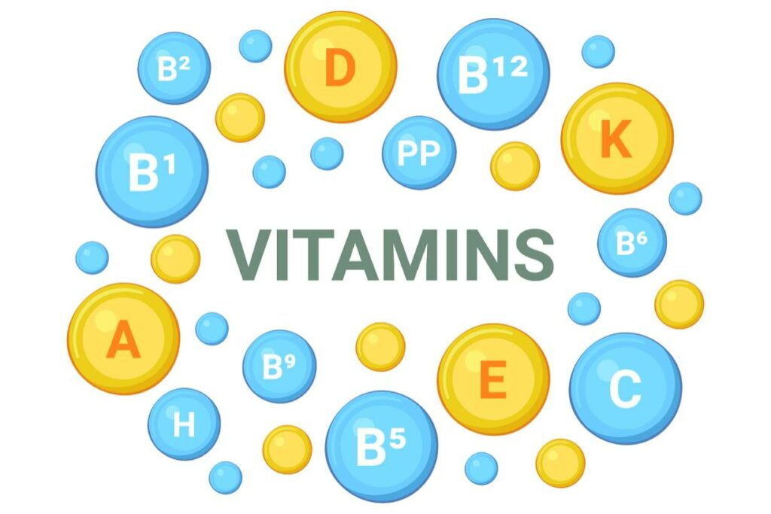
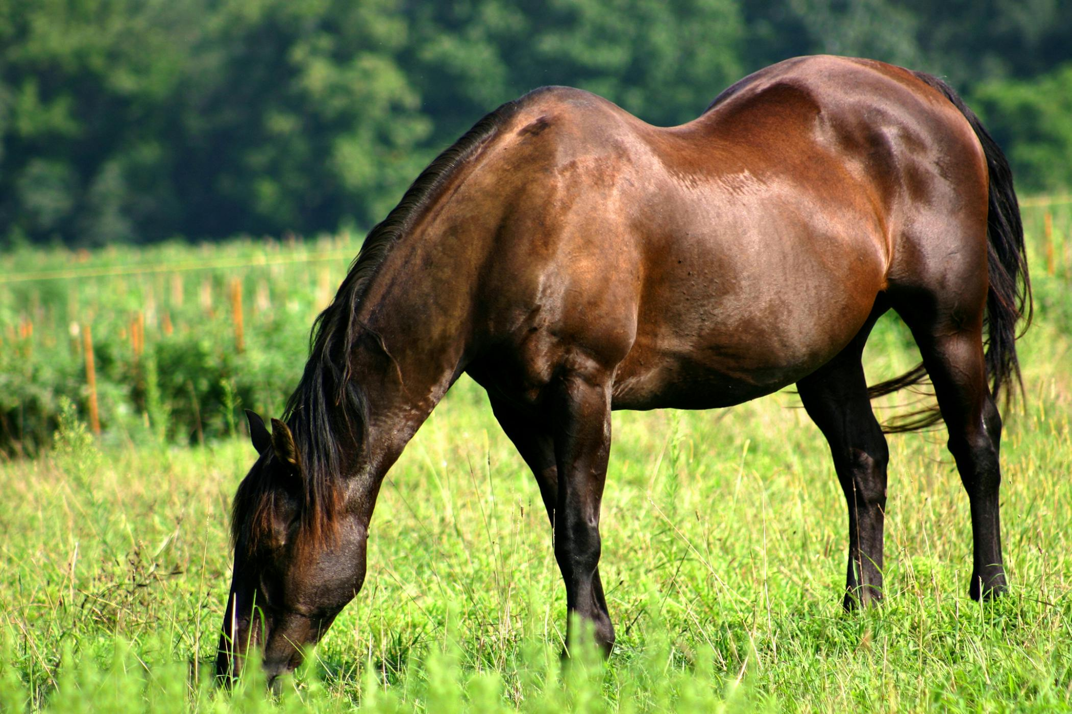
Vitamins
Vit A & E
Requirements easily met in fresh green pasture
Horses grazing for 3-4 mths/year store enough Vit A or E for another 3-6 months
Rapid degradation in hay
Vit A
Req 30 IU/kg BW (15,000 IU/500kg horse)
Increased needs for pregnant/lactating mares (2x)
Converted from beta-carotene in green forage
Important for immune function, vision, reproduction
Deficiency can cause impaired growth, infertility, eye disease, susceptibility to infection

Slide 28
Vitamins
Vit E
Req 1-5 IU/kg BW (500-2500 IU/500kg horse)
Increased need for sport, lesson, endurance horses (2x)
Important antioxidant, inflammation modulator, nerve and muscle function
Deficiencies can cause Equine Motor Neuron Disease, Equine Degenerative Myeloencephalopathy, muscle tremors, weakness, abnormal sweating
Enhances absorption of Se

Slide 29
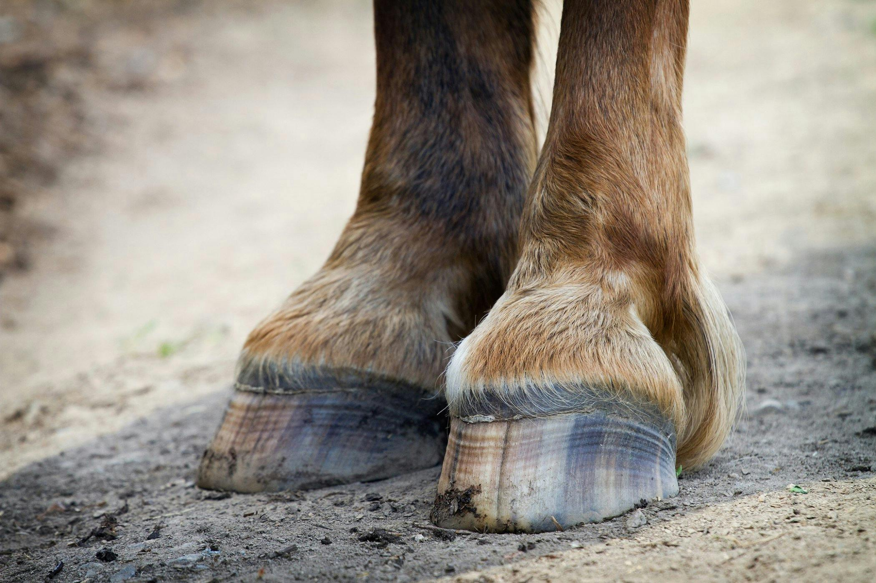
Vitamins
Vit D
Horses exposed to > 4 hrs sunlight per day or consume sun-cured hay do not have dietary requirement for Vit D
Req 500 IU/kg feed adults or 1000 IU/kg feed young
Important for bone, muscle and immune function
Vit K and B Vitamins
Synthesized in adequate amounts in the digestive tract, caecum and colon
B Vitamins important for energy generation, nervous system function and RBC formation
Vit K important for blood clotting, bone health, immune function
Biotin
Req 15-25 mg/day
Improves hoof growth and quality, skin and coat health

Slide 31
Hay: How to choose
Physiology
Nutritional Reqs
Hay
Supplements

Slide 32
Feeding Requirements
2% Body Weight rule of thumb
Higher (3% BW) for ‘Hard-keepers’
Lower (1.5% BW) for ‘Easy-Keepers’ and EMS
Fed as hay (with functional dentition)
Fed as hay cubes or pellets (with poor dentition)
Can supplement with other fiber sources (if needed)

Slide 33
NSC in hay types
Alfalfa ~ <11% NSC
Timothy ~ 10-15% NSC
Local grass ~ 12-18% NSC
Teff ~ < 11% NSC
Feeding Requirements
<13% Non-EMS & senior horses
<15% Growing and High-performance horses
<11% EMS horses

Slide 34
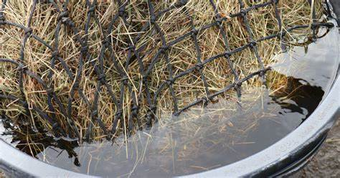
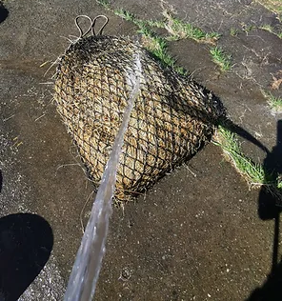
NSC Too high?
Soaking for 60 min in cold water or 30 min in hot water
Study showed soaking can reduce NSC between 3%-30% **BIG RANGE**
Drain water after soaking
Soak once daily then hang all meals to dry
Do not over-soak - will ferment
Spraying doesn’t help
Does not affect protein concentration
Will leach Vitamins and Minerals

Slide 35
Structural Fibers
Acid Detergent Fiber (ADF)
Least digestible part of the plant
More mature plants have higher ADF (1st cut hay)
High ADF +% = Lower Digestibility
Recommend ADF <40%
Neutral Detergent Fiber (NDF)
Represents total cell wall content
High NDF % = Lower palatability
Includes ADF + Hemicellulose
Recommend NDF between 50-60%

Slide 36
CP in hay sources
Grass ~ 9-11% CP (Range 6-14% CP)
Local grass hay 6-10% CP, high NSC
Usually needs other supplemental hay
Teff ~ 11-13% CP (Range 10-14% CP)
Timothy ~ 12-14% (Range 10-16% CP)
Good single hay source
Often good choice for allergenic or EMS horse
Alfalfa ~ 20-22% CP (Range 18-24% CP)
Excess is fermented in Caecum/Colon
Requirements vary with age
Young/growing/pregnant 14-16%
Adult performance 10-14%
Adult maintenance 10-12%
Senior 12-14%

Slide 37
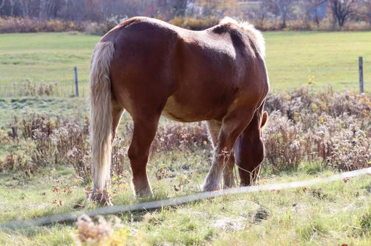
Suboptimal protein or amino acid levels in the diet can cause:
Loss of muscle mass
Poor growth
Slow recovery from illness
Poor performance
Rough coat
Weak hooves
Early pregnancy loss
Impaired immunity
Poor wound healing

Slide 39
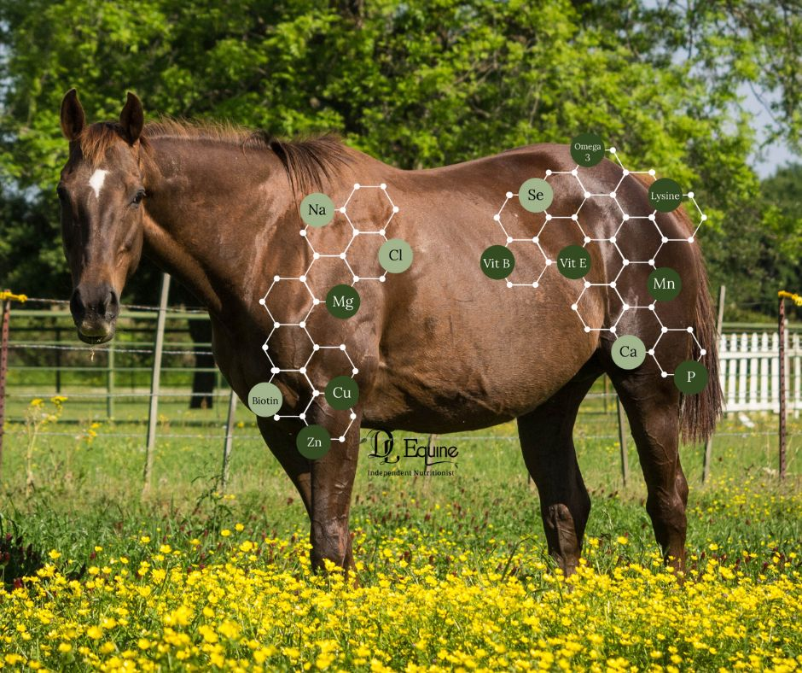
Basic Supplementation
Physiology
Nutritional Reqs
Hay
Supplements

Slide 40
Daily Nutrient Requirements met by Hay vs Pasture
Basic Requirements:
Good quality hay
adequate DE and Protein
Some vitamins and trace minerals
Salt
Now what?
Notes:
Why is more protein met in hay vs pasture?
Basic necessities are good quality hay (high enough in DE and protein), some trace minerals, Vit E, Vit A and salt

Slide 41
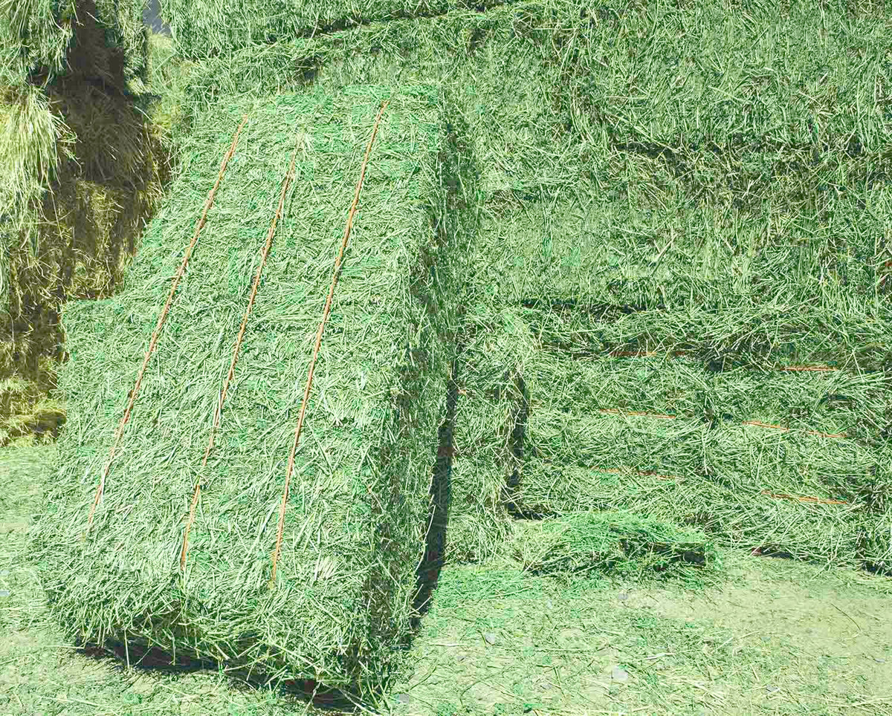
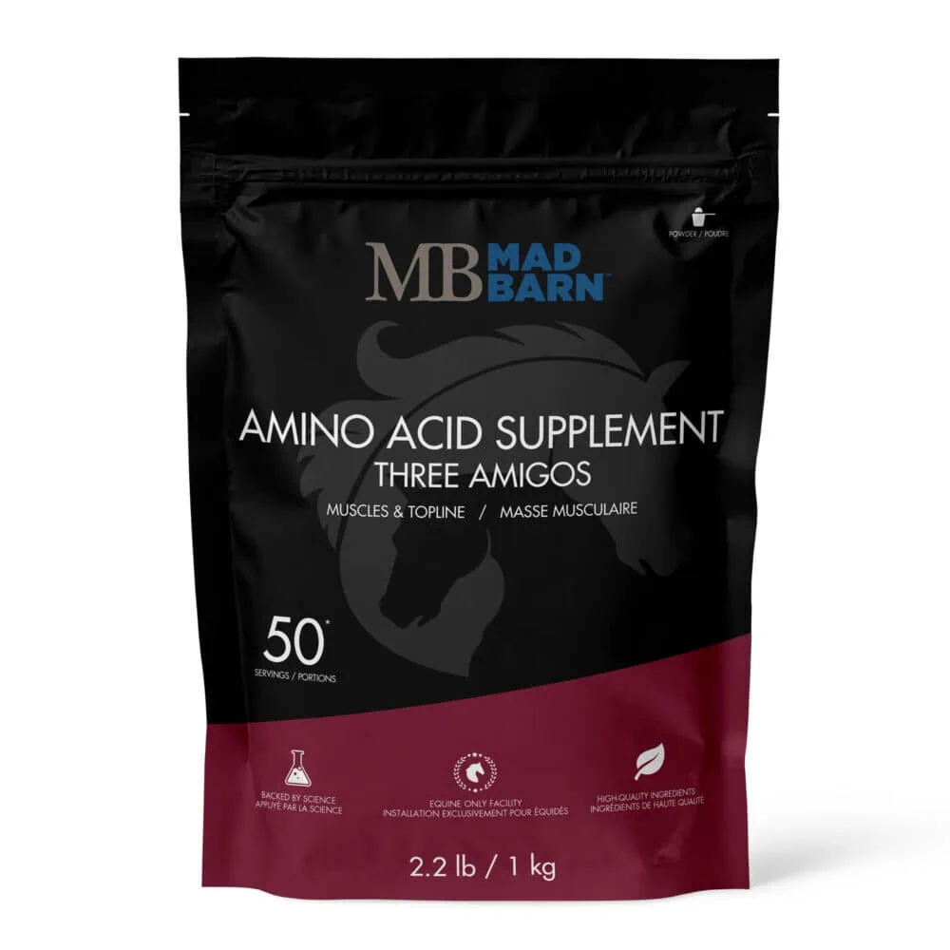
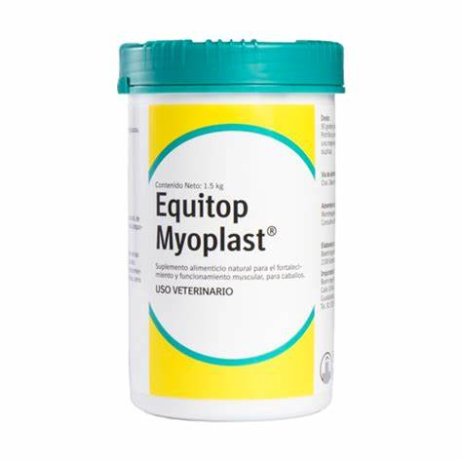
Protein Supplementation
Alfalfa
Should not exceed 50% hay by weight
Avoided in horses with EMS/IR
Leaves high in NSC/Simple sugars
Avoided in horses with allergies

Slide 42
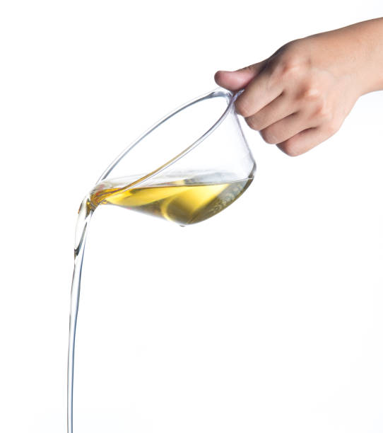
Fat Supplementation
For weight gain
No-sugar calorie source
Horses with poor dentition or ‘hard-keepers’
Max 2 cups oil /day in divided meals
Increase by ¼ cup weekly
Omega FA
Omega 3 FA : Anti-inflammatory
Omega 6 FA : Skin and coat health
Ratio is important : 2-4:1

Slide 43
Type of Feed | Amount | Omega 3 FA (g) | Omega 6 FA (g) | Tocopherol (IU)
Pasture | 22lbs | 100-150 | 25 | 1100
Hay | 22lbs | 18-100 | 5 | 0
Fresh Ground Flax | 100gm | 22 | 5 | 20
Soaked Chia Seeds | 15gm | 10 | 3
Flax Oil | 15mL (1 Tbsp) | 8 | 2 | 75
Hemp Oil | 15mL (1 Tbsp) | 3 | 7.5 | 15
Camelina Oil | 15mL (1 Tbsp) | 4 | 3 | 15
Canola Oil | 15mL (1 Tbsp) | 1.5 | 2.8
Corn Oil | 15mL (1 Tbsp) | 0 | 8

Slide 44
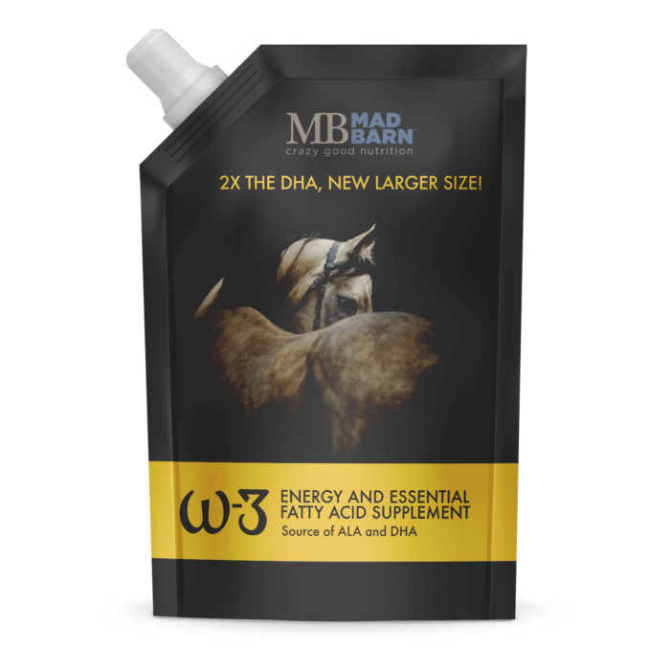
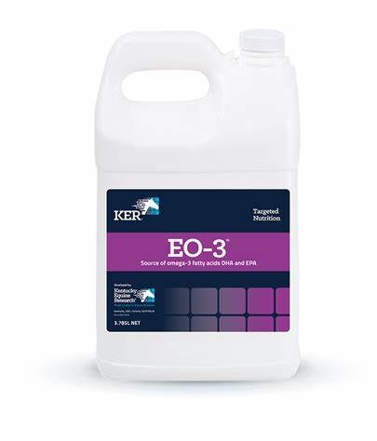
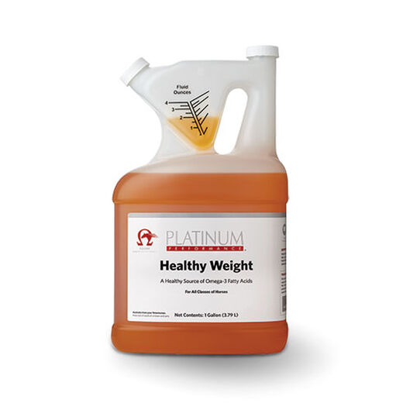
EPA and DHA 28% 5500mg per 30 mL
ALA 4%, 1000mg per 30 mL
ALA 48% 1000mg per 30 mL
DHA 450mg per 30 mL

Slide 45
Electrolyte Supplementation
Na Cl
Will seek out and consume NaCl to meet their needs
May consume excess due to boredom (fresh water!)
May eat dirt if no salt source is available
K
Soaking hay with leach K as well as sugars
Forced doses of large quantities can trigger fatal cardiac arrhythmias
Mg
Higher doses can cause sedation and/or diarrhea
Ca
Legume hay high in Ca
Higher doses can lower Vit A levels
Electrolytes lost in sweat
Major : Na, Cl, K
Minor : Ca & Mg

Slide 46
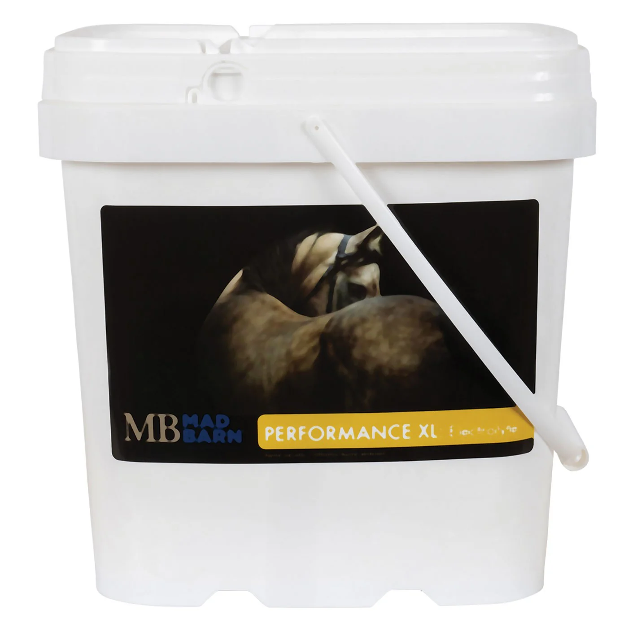
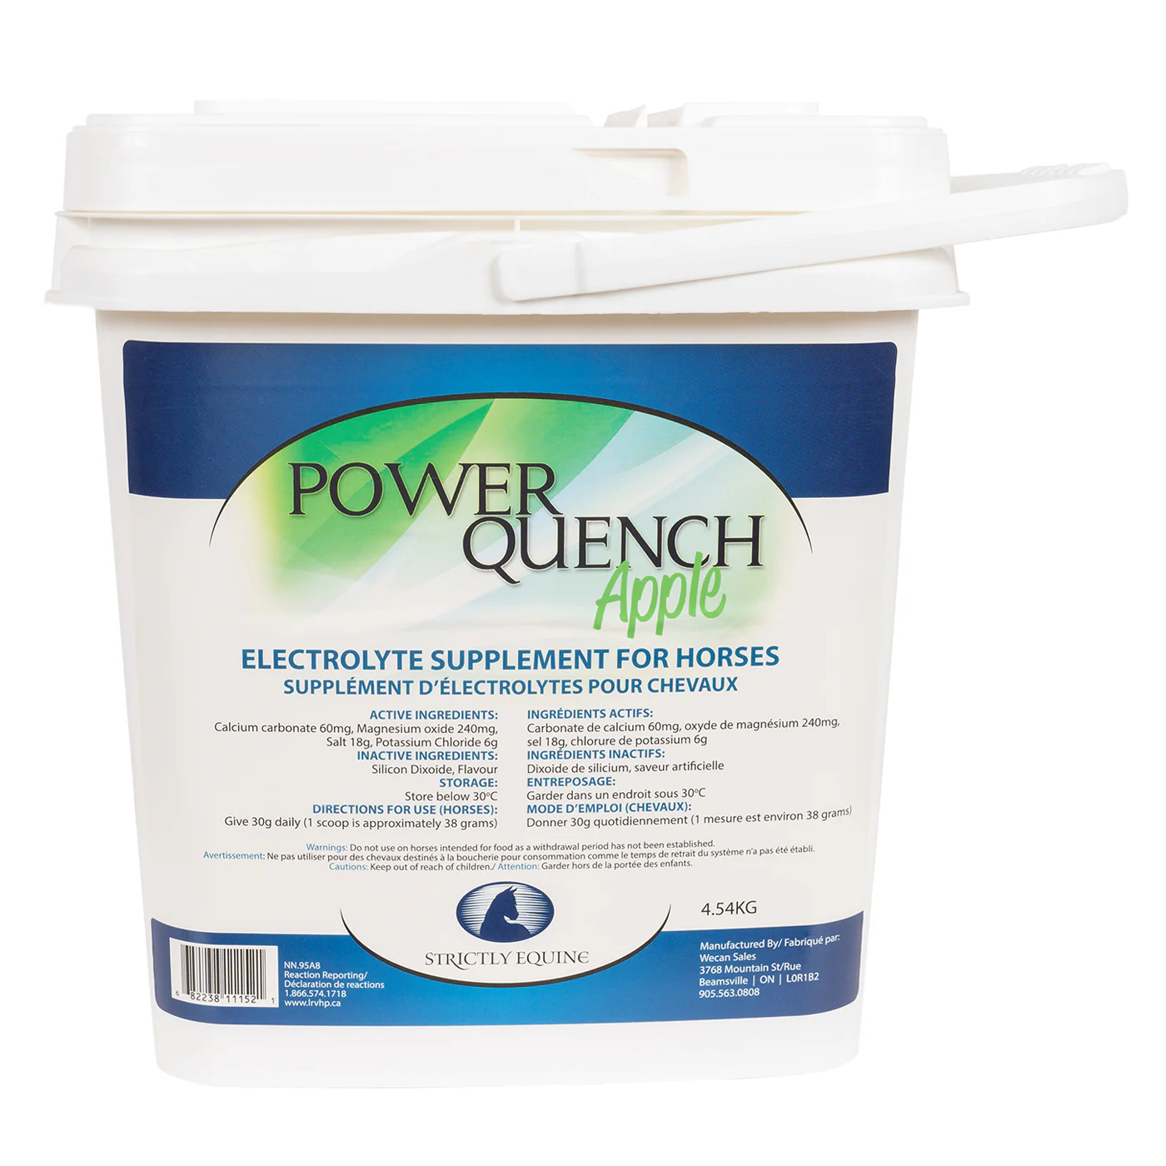
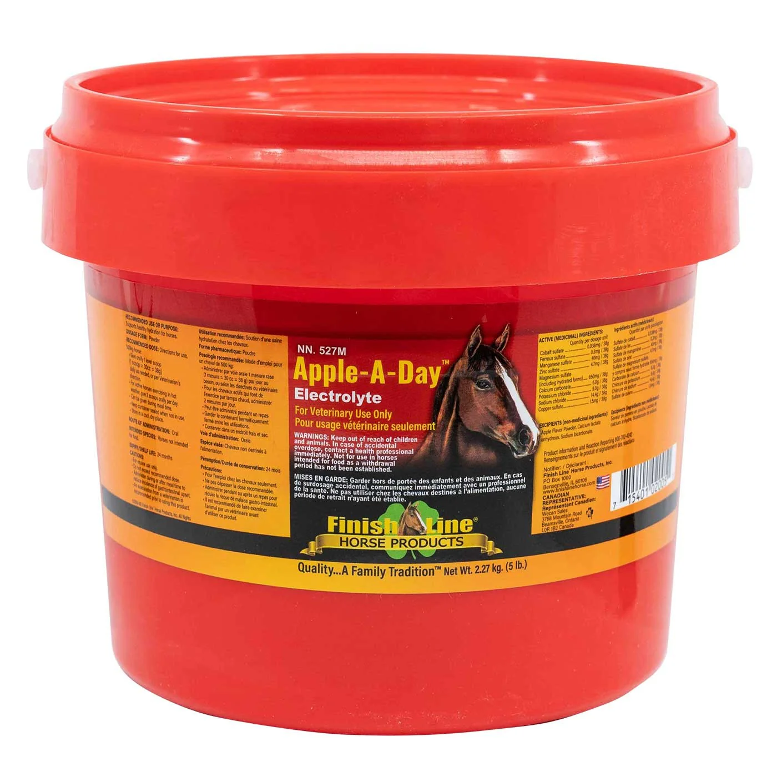
Electrolyte Supplementation
Careful of the added sugar!
Most products are 50% sugar!

Slide 47
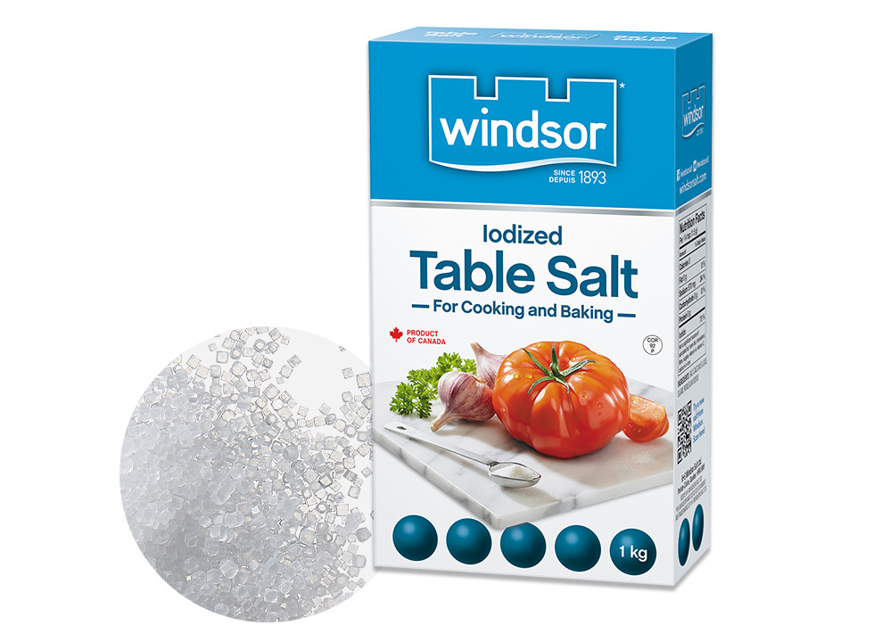
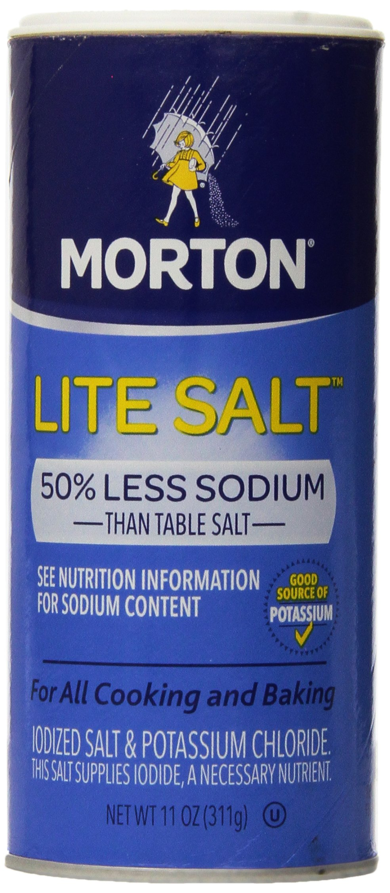
Electrolyte Supplementation
+
1 Tbsp Table Salt (NaCl) + 1 Tbsp Lite Salt (KCl)

Slide 48
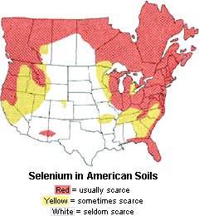
Selenium Supplementation
Daily requirement is 1-3 mg/day
Two main formulations
Salt-based / “Inorganic” - 50% absorption
Yeast-based / “Organic” - 90% absorption
(Greater bioavailability)
Narrow safety range - toxicity is possible
Selenium Toxicosis signs:
Blindness, head pressing, hoof deformities, hair loss, colic, diarrhea, sweating, lethargy, elevated heart and respiratory rates

Slide 49
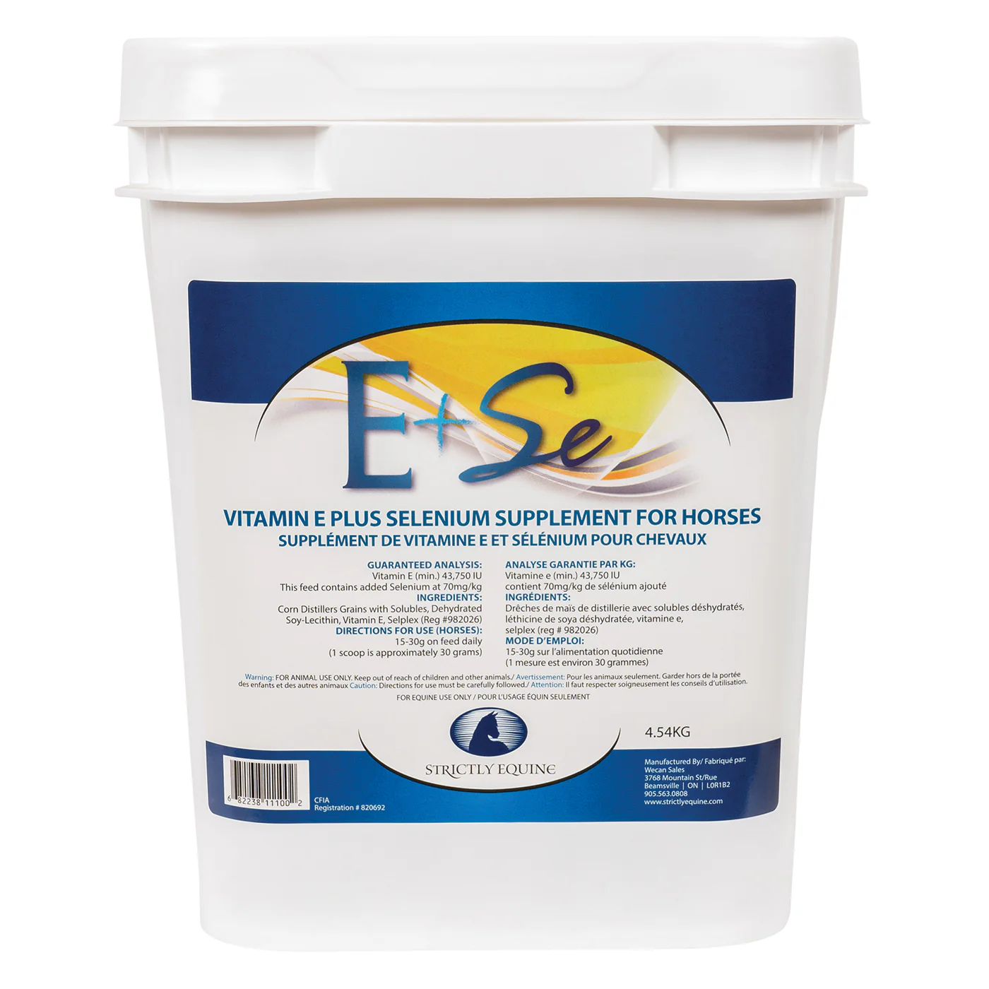
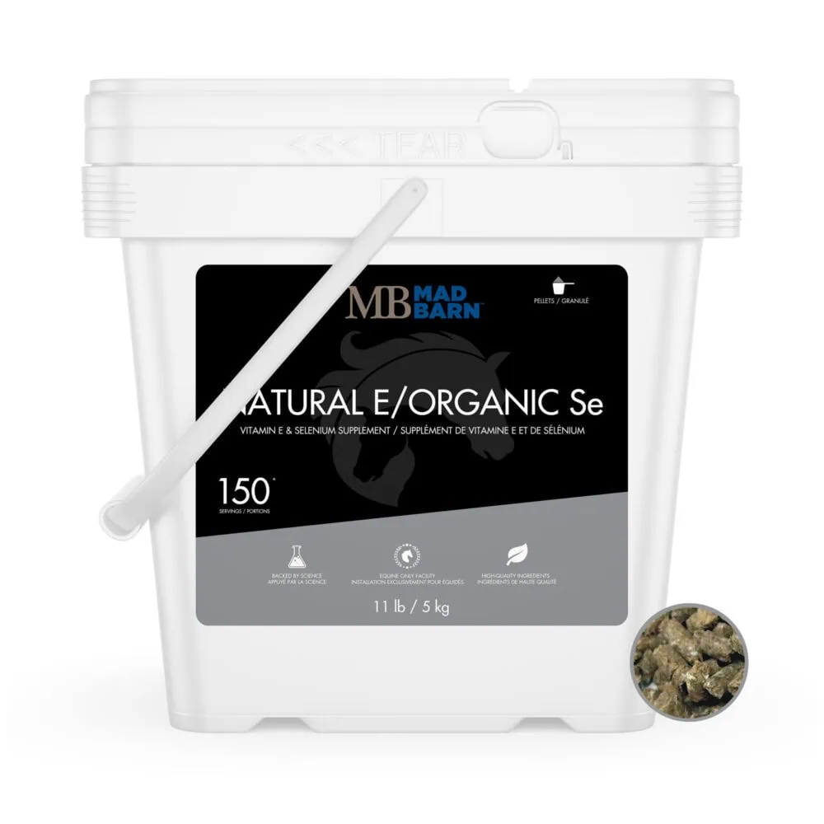
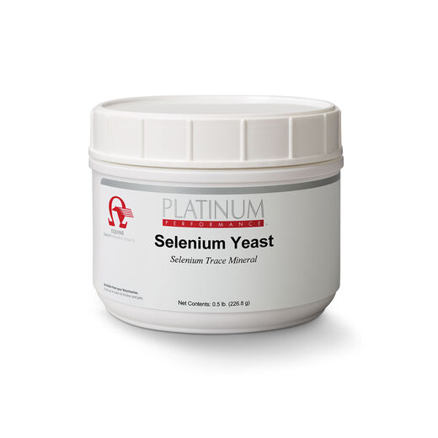
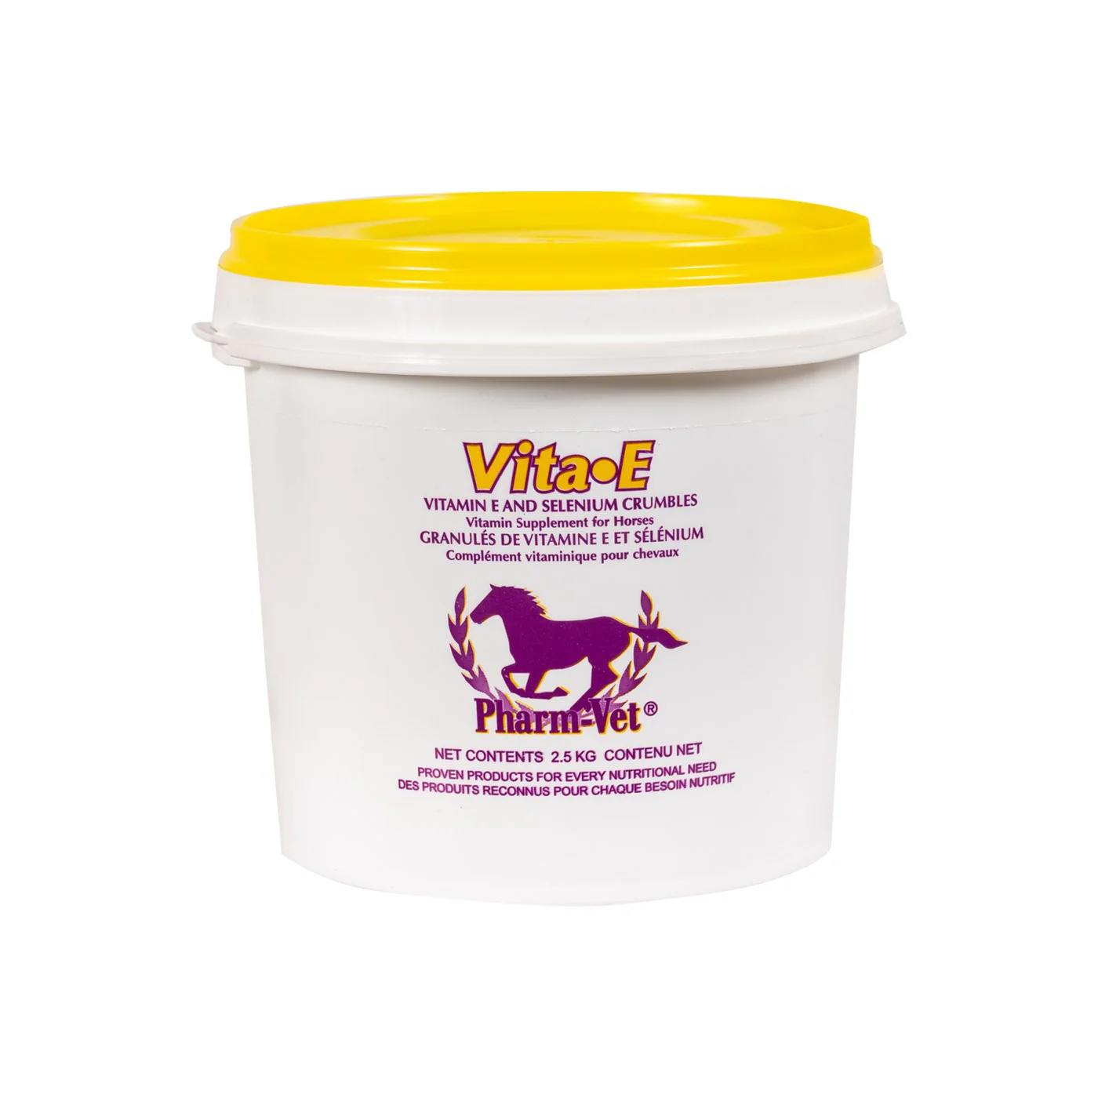
Se
Selenium Yeast and SelPlex vs. Sodium Selenite

Slide 50
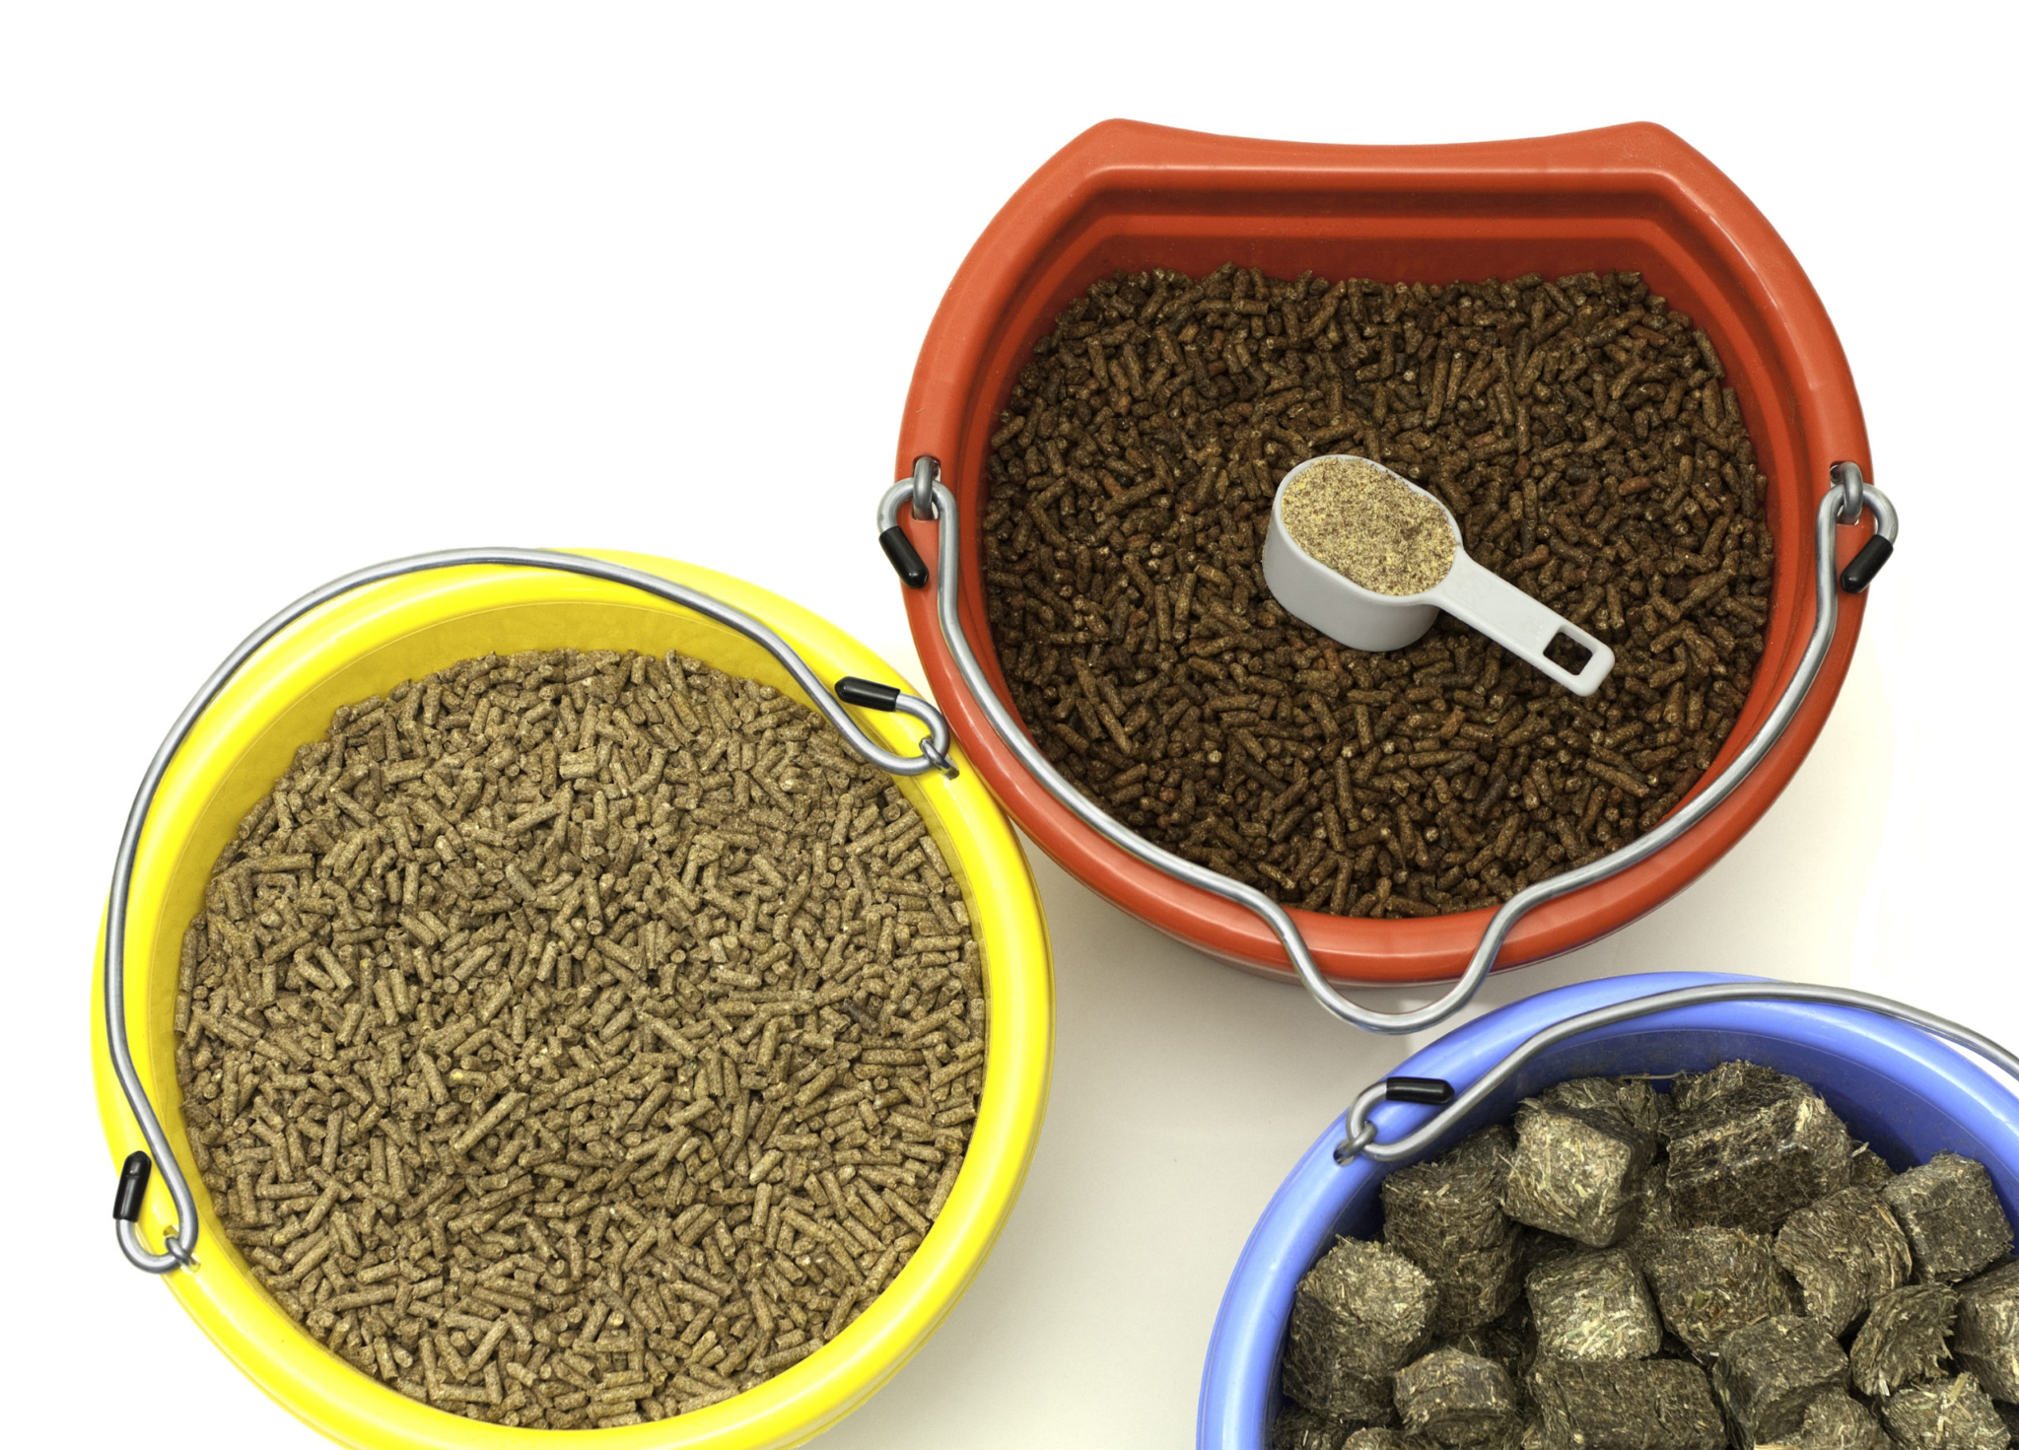
Zn & Cu Supplementation
Daily Requirements are 400-800mg Zn and 100-200mg Cu
Ratio of 4:1 is important
Two main formulations
Salt-based / “Inorganic” (Sulfates & Oxides)
Protein-based / “Organic” / Chelated
Methionine > Glycine
(Greater bioavailability)

Slide 51
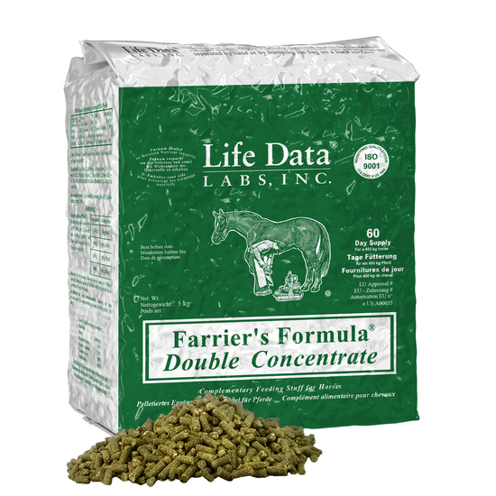
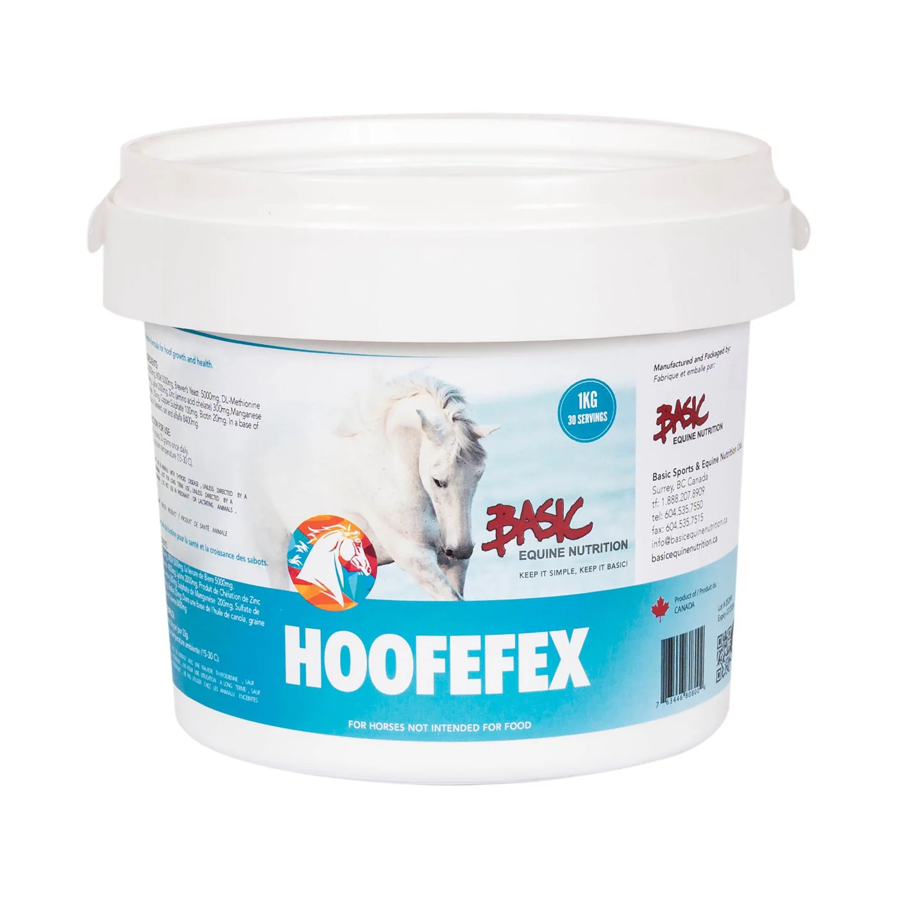
Zn & Cu

Slide 52
Trace Mineral Supplementation
Competition for absorption by divalent ions (2+):
Fe, Cu, Zn, Ca, Se
Excess Fe & Ca in our feeds and waters may impair absorption of already deficient trace minerals
Excess Fe (water/soil/forage) may inhibit Se, Cu, and Zn absorption
Excess Ca (alfalfa) may inhibit Se, Cu, and Zn absorption
Excess Cu suppl may inhibit Zn absorption
Excess Zn suppl may inhibit Cu and Se absorption
So what should we mix our supplements in?

Slide 53
Vit A Supplementation
Usually supplemented as Retinol compounds
Stable in feeds and supplements
Converted to Vit A in the liver
Rec’d 15,000-30,000 IU/day
Maximum is 16,000 IU/kg feed
Vit A toxicity is possible but unlikely
can cause bone fragility, skin lesions, bone spurs, developmental orthopedic defects
Usually added to a general vitamin & mineral supplement

Slide 54
Vit E Supplementation
Highly susceptible to degradation/oxygenation
Unstable in feeds and supplements
Two forms:
Artificial dl-alpha-tocopherol - poor absorption
Natural d-alpha-tocopherol - good absorption
Two formulations:
Powder form - less stable
Oil form - more stable and better absorption
Rec’d dose 500-1000 IU/day
Maximum of 10,000 IU/day
Vit E toxicity is possible but unlikely
can cause spontaneous bleeding

Slide 55
Biotin and B Vitamins Supplementation
Beneficial to add to Zn-Methionine and Cu for hoof growth and quality, skin and coat quality
Supplementation helpful after diet change or major GI disturbances
Rec dose 15-25 mg/day

Slide 56
Se Supplement A
Se Supplement B
Se Supplement C
Se Supplement D
Se Form : SelPlex (organic)
Conc: 70 mg/kg
Rec’d Dose : 30 gm
Se dose: 2.1 mg
Cost: $0.43/dose
Se Form : Se Yeast
Conc: 75 mg/kg
Rec’d Dose : 40 gm
Se dose: 3 mg
Cost: $1.28/dose
Se Form : Se Yeast
Conc: 2000 mg/kg
Rec’d Dose : 1 gm
Se dose: 2 mg
Cost: $0.29/dose
Se Form : Sodium Selenite
Conc: 70 mg/kg
Rec’d Dose : 14gm *2
Se dose: 1 mg *2
Cost: $0.28/dose *2

Slide 57
Vit E Supplement A
Vit E Supplement B
Vit E Supplement C
Vit E Supplement D
E Form : Natural
Conc: 500 IU/mL
Rec’d Dose : 6 mL
Vit E dose: 3000 IU
Cost: $3.20/dose
E Form : Natural
Conc: 75000 IU/kg
Rec’d Dose : 40 gm
Vit E dose: 3000 IU
Cost: $1.28/dose
E Form : Natural
Conc: 623,000 IU/kg
Rec’d Dose : 6.42 gm
Vit E dose: 4000 IU
Cost: $3.32/dose
E Form : Artificial
Conc: 44000 IU/kg
Rec’d Dose : 14gm * 5
Vit E dose: 600 IU * 5
Cost: $0.28/dose *5

Slide 58
Zn/Cu Supplement A
Zn/Cu Supplement B
Zn/Cu Supplement C
Zn/Cu Supplement D
Zn Form : Chelate
Cu Form : Sulphate
Zn dose : 300mg
Cu dose: 100mg
Cost: $1.53/dose
Zn Form : Protein
Cu Form : Protein
Zn dose : 300mg
Cu dose: 100mg
Cost: $0.18/dose
Zn Form : Chelate
Cu Form : Chelate
Zn dose : 55mg
Cu dose: 50mg
Cost: $2.05/dose
Zn Form : Oxide
Cu Form : Sulphate
Zn dose : 255mg
Cu dose: 93mg
Cost: $2.42/dose

Slide 59
Vit/Min Supplement A
Vit/Min Supplement B
Vit/Min Supplement C
Vit/Min Supplement D
Se : 1.5 mg Se Yeast
Zn: 180 mg Zn chelate
Vit E : 1,100 IU Mixed
Vit A: 7560 IU
Cost: $3.90/day
Se : 2 mg chelated
Zn: 884 mg Zn Mixed
Vit E : 2100 IU Natural?
Vit A: 32900 IU
Cost: $1.20/day
Se : 1.5 mg Sel Plex
Zn: 480 mg Zn chelate
Vit E : 980 IU ?
Vit A: 29000 IU
Cost: $1.25/day
Se : 1.5 mg Se ?
Zn: 440 mg Zn ?
Vit E : 1,100 IU ?
Vit A: 33000 IU
Cost: $0.50/day

Slide 60
THANK YOU

